Slide 1



UNIVERSITY INSTITUTE OF ENGINEERING
COMPUTER SCIENCE ENGINEERING
Bachelor of Engineering
Design and Analysis of Algorithms(CST-311/ITT-311)
Topic: Backtracking , N Queen
DISCOVER . LEARN . EMPOWER

Slide 2
Learning Objectives & Outcomes
Objective:
To understand the concept of Backtracking and N Queen problem.
Outcome:
Student will understand
Backtracking
N Queen

Slide 3
Backtracking
Backtracking is finding the solution of a problem whereby the solution depends on the previous steps taken. For example, in a maze problem, the solution depends on all the steps you take one-by-one.
If any of those steps is wrong, then it will not lead us to the solution. In a maze problem, we first choose a path and continue moving along it. But once we understand that the particular path is incorrect, then we just come back and change it. This is what backtracking basically is.

Slide 4
General steps of backtracking
Start with a sub-solution
Check if this sub-solution will lead to the solution or not
If not, then come back and change the sub-solution and continue again

Slide 5
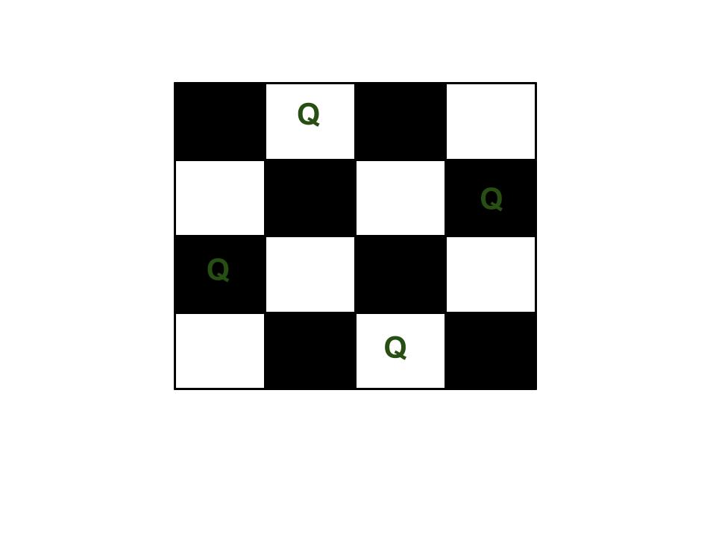
N queens on NxN chessboard
The N Queen is the problem of placing N chess queens on an N×N chessboard so that no two queens attack each other. For example, following is a solution for 4 Queen problem.

Slide 6
Naive Algorithm
while there are untried configurations
{
generate the next configuration
if queens don't attack in this configuration then
{
print this configuration;
}
}

Slide 7
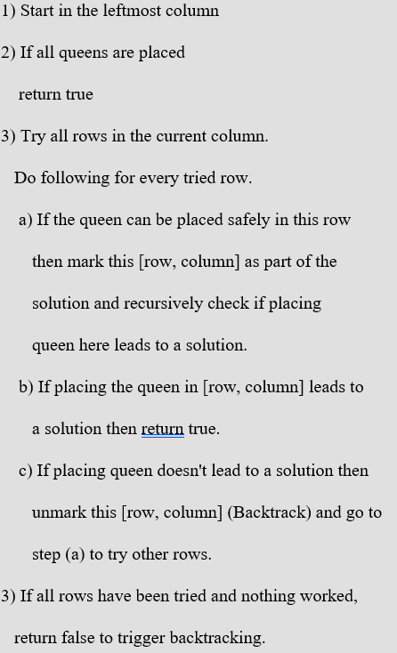
Using Backtracking Algorithm

Slide 8
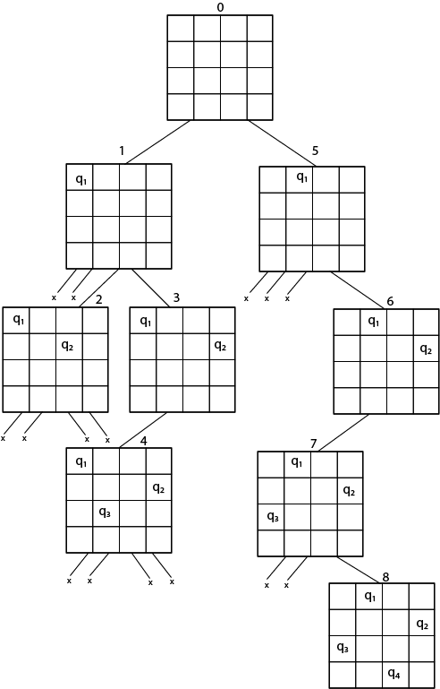

Slide 9
REFERENCES
Text books:
Cormen, Leiserson, Rivest, Stein, “Introduction to Algorithms”, Prentice Hall of India, 3rd edition 2012. problem, Graph coloring.
Websites:
https://www.geeksforgeeks.org/n-queen-problem-backtracking-3/
https://www.javatpoint.com/n-queens-problems

Slide 10
Summary
  Backtracking:
    Concept of Backtracking
    N Queen Problem

Slide 11
THANK YOU

